Slide 1
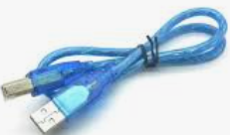
Objective: Displaying message from Arduino microcontroller into Personal Computer
Components to be used:
Arduino uno
USB Cable

Slide 2
Experiment procedures
1.Connect microcontroller into your PC
2.Type the Program CODE into computer connected on arduino
3.Compile and download the program into microcontroller
4.Open the serial monitor

Slide 3
LAB Session
Let connect the circuit diagram.

